Slide 1


M.Tech Program
Advanced Industry Integrated Programs
Jointly offered by University and LTIMindTree
Project Title
Autonomous Multi-Agent Cybersecurity Defense and Incident Intelligence Platform
NAME: RADHA GOHIL
T10002
Knowledge partner | Implementation partner

Slide 2
Autonomous Multi-Agent Cybersecurity Defense and Incident Intelligence Platform
Introduction
Existing Challenges: Windows endpoints face malware, ransomware, suspicious processes, malicious network activity, and persistence attacks.
Current Limitations: Isolated security alerts make threat correlation, attack understanding, and fast response difficult.
Proposed Solution: SENTINEL-X integrates endpoint monitoring, multi-engine threat detection, event correlation, AI-based investigation, and controlled response.
Intelligent Decision Support: AI agents support triage, investigation, risk assessment, and response recommendations using correlated threat data.
Overall Benefit: The platform improves threat detection, attack visibility, response speed, and explainable endpoint protection.

Slide 3
Autonomous Multi-Agent Cybersecurity Defense and Incident Intelligence Platform
Objective
Monitor file, process, network, and registry activity in real time.
Detect malware, ransomware, suspicious behaviour, and network threats.
Use ML, anomaly detection, and behavioural analysis for threat detection.
Correlate events and generate a unified threat score.
Use AI agents for investigation, risk assessment, and response recommendations.
Provide explainable and controlled threat response.
Build an installable Windows endpoint security application.

Slide 4
Autonomous Multi-Agent Cybersecurity Defense and Incident Intelligence Platform
Scope
Real-time monitoring of files, processes, network connections, and registry activity on Windows.
Detection of malware, ransomware, suspicious behaviour, and network attacks.
PE[Portable Executable]-file analysis, behavioural analysis, and anomaly detection.
Detection fusion and attack-event correlation for better threat assessment.
AI agents for triage, investigation, risk analysis, and response recommendations.
Controlled security actions such as quarantine, process termination, persistence removal, and network blocking.
Development of an installable Windows endpoint security application with real-time monitoring and intelligent response.

Slide 5
Autonomous Multi-Agent Cybersecurity Defense and Incident Intelligence Platform
Literature Review
Study | Approach | Key Contribution | Limitation / Research Gap
Anderson & Roth – EMBER | PE features + ML | Static malware detection | No full endpoint monitoring
Raff et al. – MalConv | Deep learning on raw bytes | End-to-end malware detection | High computation cost
Du et al. – DeepLog | LSTM-based log analysis | Detects abnormal behavior | Mainly log-focused
Milajerdi et al. – HOLMES | Event correlation + attack graph | Reconstructs attack chains | Limited endpoint protection
Han et al. – UNICORN | Provenance graph + anomaly detection | Detects stealthy attacks | Complex and resource-heavy
van Ede et al. – DeepCASE | Contextual event analysis | Improves alert prioritization | Limited automated response
Proposed SENTINEL-X | ML + behaviour + anomaly + AI agents | Integrated endpoint detection, investigation, and response | Bridges isolated security tools into one platform

Slide 6
Autonomous Multi-Agent Cybersecurity Defense and Incident Intelligence Platform
Summary of Literature
Existing studies usually focus on individual areas such as static malware detection, behavioural anomaly detection, attack correlation, provenance analysis, or security-event prioritization. There is limited work combining these capabilities into a single integrated, explainable, AI-driven Windows endpoint security platform.
• Proposed Solution:
Endpoint Monitoring → Malware Detection → Behavioural & Anomaly Detection → Detection Fusion → Event Correlation → AI Investigation → Risk Assessment → Controlled Response → Explainable Decision Support.

Slide 7
Autonomous Multi-Agent Cybersecurity Defense and Incident Intelligence Platform
Additional Information
Endpoint Protection: Monitors files, processes, network connections, registry changes, startup activity, and system events.
Malware & Ransomware Défense: Uses PE analysis, ML-based malware detection, ransomware behaviour monitoring, and quarantine support.
Behaviour & Anomaly Detection: Identifies suspicious process chains, unusual endpoint activity, and previously unseen threats.
Network Security: Detects suspicious connections and network attacks using live telemetry and ML-based network detection.
Detection Fusion: Combines outputs from malware, behaviour, anomaly, ransomware, and network engines into a unified threat score.
Attack Investigation: Correlates related endpoint events and builds an attack graph/timeline to understand the full attack sequence.

Slide 8
Autonomous Multi-Agent Cybersecurity Defense and Incident Intelligence Platform
Additional Information
AI Agents: Uses specialized agents for triage, correlation, investigation, risk assessment, and response recommendation.
Explainable Security: Shows why a threat was detected, what evidence was used, the risk level, and the recommended action.
Adaptive Autonomy: Supports different response levels from monitoring and recommendation to controlled automatic containment.
Response Actions: Supports quarantine, process termination, network blocking, persistence cleanup, rescanning, and incident handling.
Future Enterprise Scope: Can be extended to centralized multi-device management, security policies, remote response, reporting, and EDR/XDR-style capabilities.

Slide 9
Autonomous Multi-Agent Cybersecurity Defense and Incident Intelligence Platform
Modules to cover
Module 1: Endpoint Telemetry Collection - Real-Time System Monitoring
• Process start/stop and parent-child monitoring
• File create, modify, rename and delete monitoring
• Network connection monitoring
• Registry and startup activity monitoring
Module 2: Malware & Threat Detection- Multi-Engine Security Detection
• Static PE malware analysis using hashes, entropy, sections, imports and exports
• ML-based malware and network attack detection
• Behavioural, anomaly and ransomware detection
• Threat type, confidence, severity and risk prediction

Slide 10
Autonomous Multi-Agent Cybersecurity Defense and Incident Intelligence Platform
Modules to cover
Module 3: Detection Fusion & Correlation - Unified Threat Analysis
• Combine outputs from multiple detection engines
• Generate a unified threat score
• Correlate file, process, network and registry events
• Identify related suspicious activities and attack patterns
Module 4: Threat Investigation - Attack Intelligence & Analysis
• IOC and event-history analysis
• MITRE ATT&CK mapping
• CVE and vulnerability context where applicable
• Attack timeline and attack-graph generation

Slide 11
Autonomous Multi-Agent Cybersecurity Defense and Incident Intelligence Platform
Modules to cover
Module 5: AI Agent Intelligence - Autonomous Security Analysis
• Triage Agent for alert prioritization
• Correlation Agent for linking related events
• Investigation Agent for attack analysis
• Risk Agent for severity and impact assessment
• Response Agent for remediation recommendations
Module 6: Response & Remediation - Controlled Threat Response
• File quarantine and restoration
• Suspicious process termination
• Network/IP blocking
• Persistence cleanup and rescan actions
• Policy/user-controlled approval before sensitive actions

Slide 12
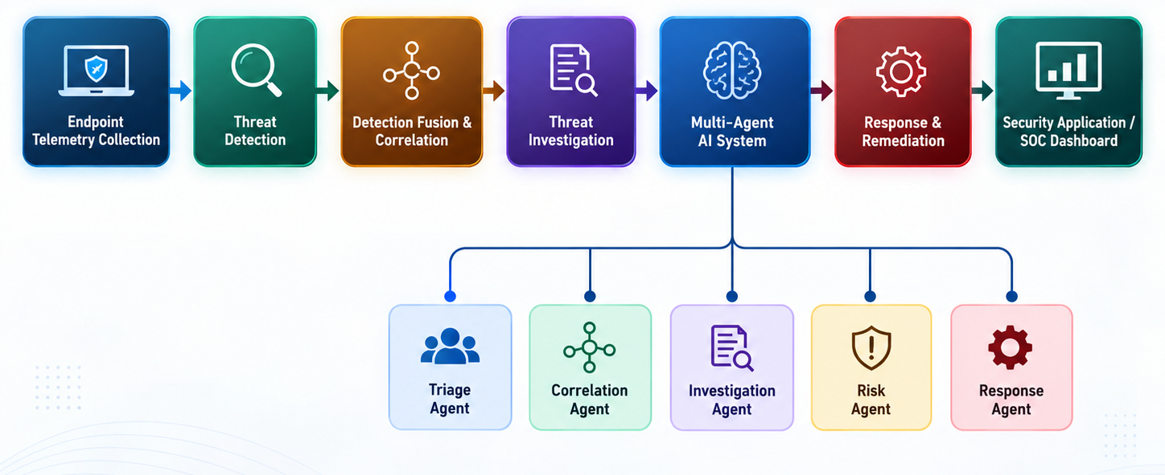

Slide 13
